Slide 1
Wakeup Scheduling in Wireless Sensor Networks
Abtin Keshavarzian Robert Bosch Corporation Research
Huang Lee Stanford University

Slide 2
Motivation
Wakeup scheduling approaches used in existing WSN MAC protocols is not good enough. Some have long delay while others are too complex.
The authors propose a cross-layer MAC protocol for WSN.
Performance is improved by assigning each node to more than one parent. Each sensor will have multiple routes to choose.

Slide 3
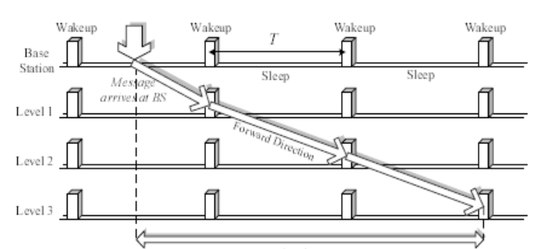
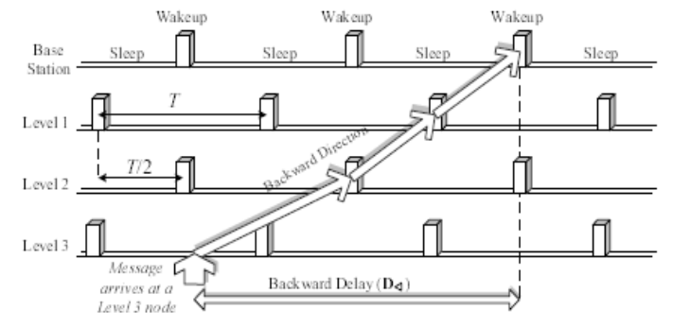
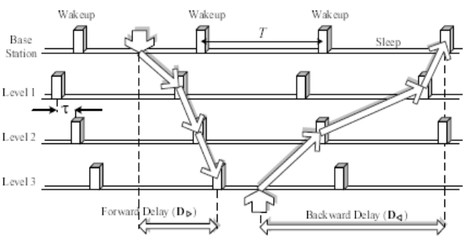
Existing Works
Fully Synchronized.
Shifted Even and Odd Pattern.
Ladder Pattern.
The author evaluated the performance of these approaches in terms of forward / backward delay and energy consumption.

Slide 4
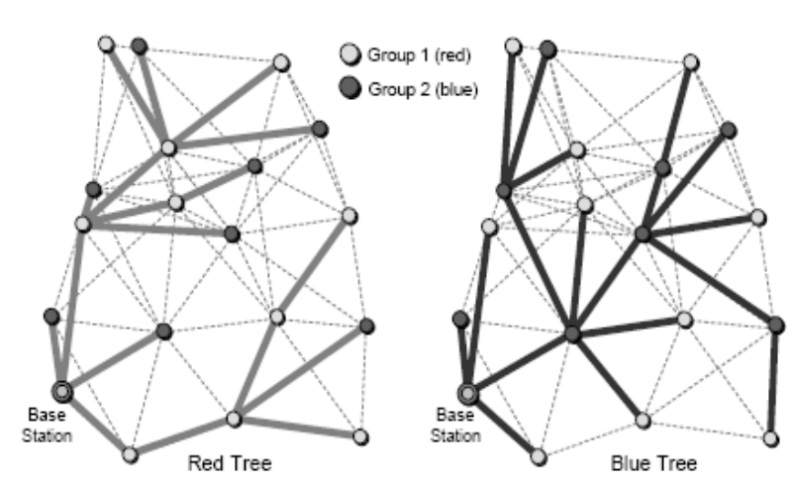
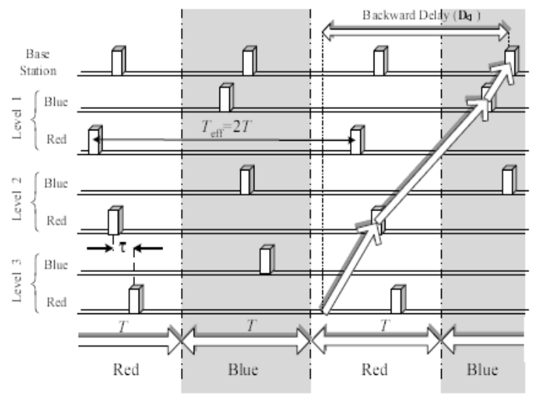
Author’s Solution
Multi-parent + Ladder Pattern.
Reason: Ladder pattern is simple and has short forward delay. Backward delay can be reduced by having multiple parents

Slide 5
Parent Assignment
How to divide the nodes into g groups?
The authors proved that such problem is NP-complete even for the simplest case of g=2
The authors proposed an approximate algorithm.

Slide 6
Contributions
Analyzed existing works about wakeup scheduling in MAC protocols for WSN.
Proposed a new idea about multi-parents assignment and compared its performance.
Based on the new idea, investigated the nodes coloring algorithm and proved it is NP-complete.
Proposed an approximate algorithm and evaluated its performance.

